Slide 1
DATA GENERATION/SCALING
ELECTRICAL APPLIANCES CONSUMPTION DATA
Jason Achonu

Slide 2
Introduction
Electrical appliance usage data is very useful for planning, forecasting to aid in efficient use of Electrical resource. Unfortunately, real electrical datasets are very expensive and difficult to collocate due to the time and amount of resources needed.
The aim of this project is to apply Deep Generative models to produces realistic Electricity appliance consumption data.

Slide 3
About the dataset
The dataset used was retrieve from Pecan Street dataset (DATAPORT). The data consists of energy consumption readings at 1-minute, 5-minutes and 1-hour interval. The data was covers the period of 2013 to 2019 across seven states in the US and from 1534 houses.
In this project the 1-hour interval reading was obtained from houses in California, Colorado and Texas for the year 2015 which amounted to 1467 households.
The model was trained using the Texas and Colorado data, while California Data used as the Validation set.

Slide 4
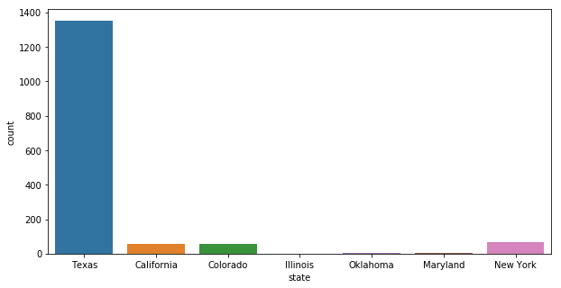
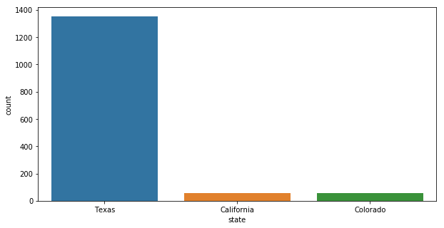
Exploratory Data Analysis

Slide 5
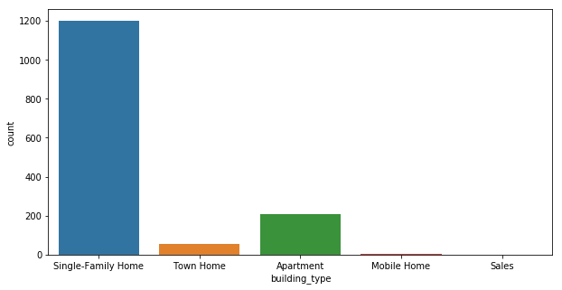
Exploratory Data Analysis - Cont.

Slide 6
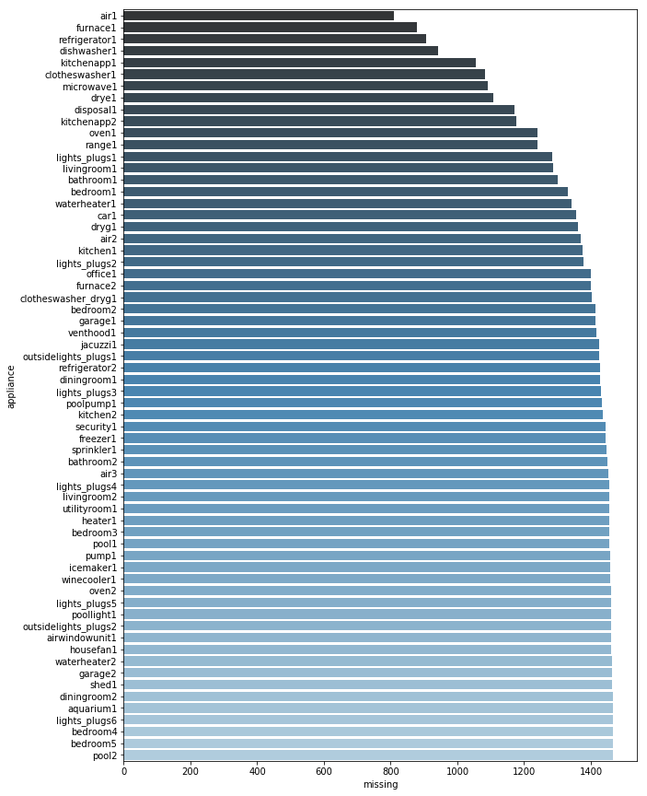
Exploratory Data Analysis - Cont.

Slide 7
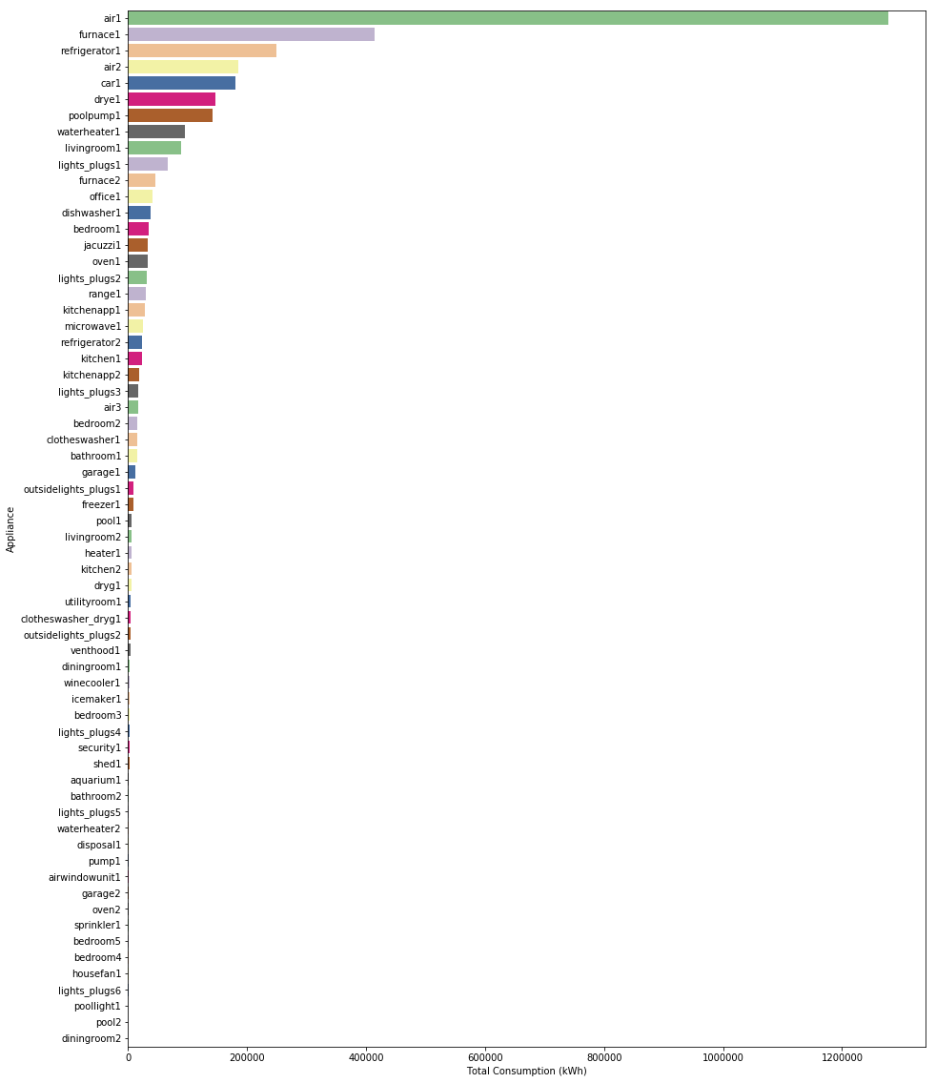
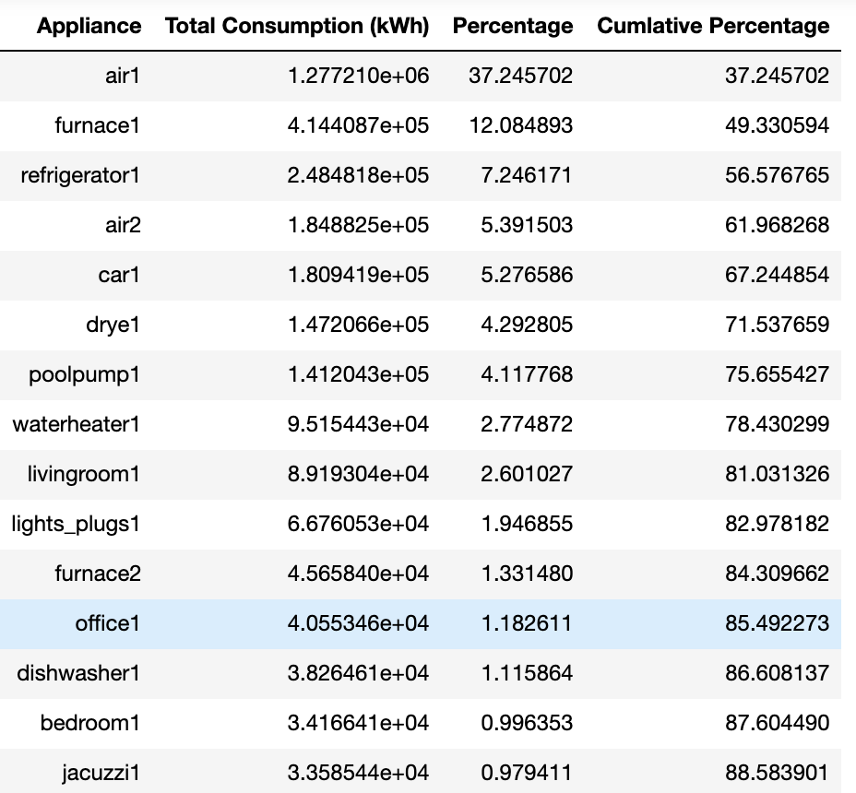
Exploratory Data Analysis - Cont.

Slide 8
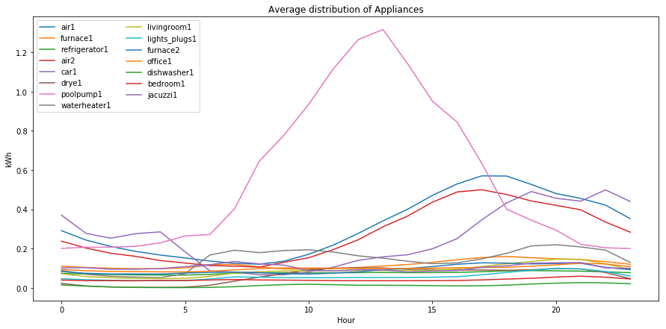
Exploratory Data Analysis - Cont.

Slide 9
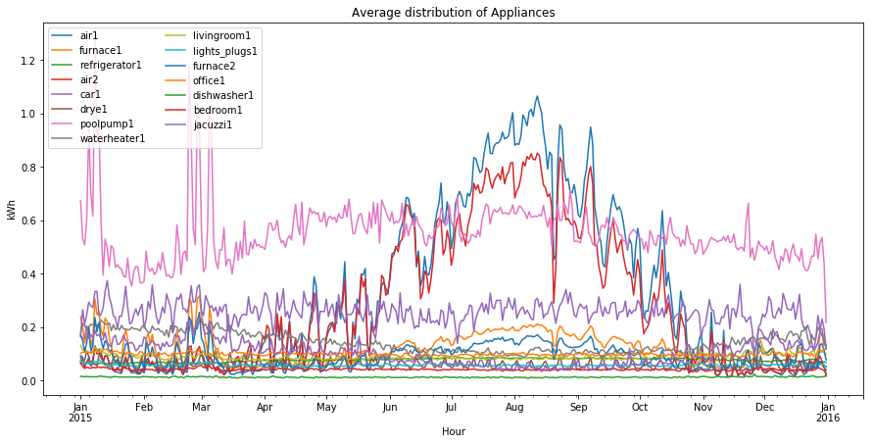
Exploratory Data Analysis - Cont.

Slide 10
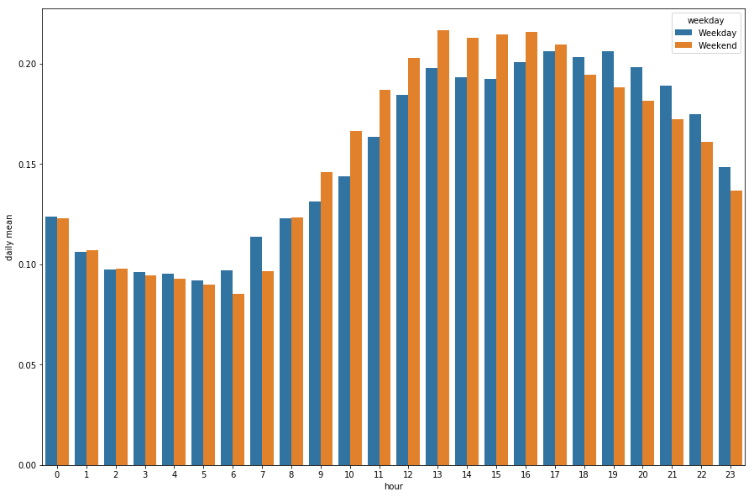
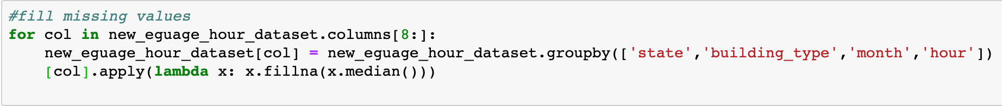
Exploratory Data Analysis - Cont.

Slide 11
Variational Autoencoder
https://lilianweng.github.io/lil-log/2018/08/12/from-autoencoder-to-beta-vae.html

Slide 12
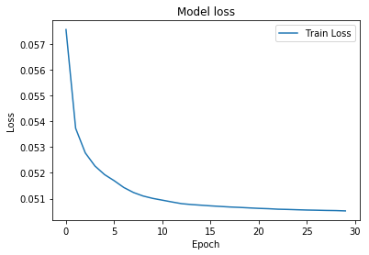
VAE LOSS FUNCTION

Slide 13
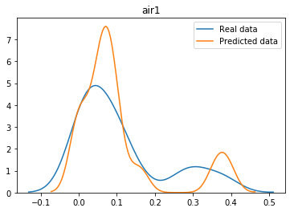
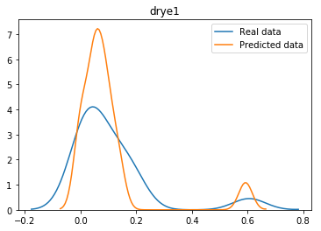
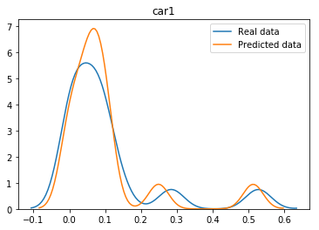
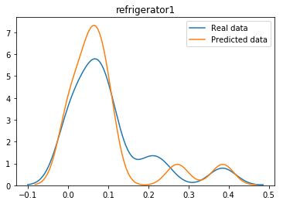
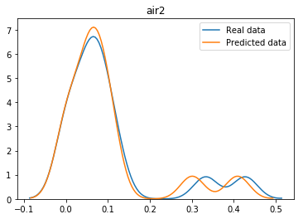
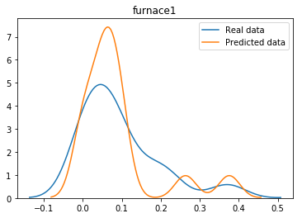
VAE-Model Evaluation
Overall the model performs on the California dataset.

Slide 14
Generative Adversarial Network
https://www.analyticsvidhya.com/blog/2017/06/introductory-generative-adversarial-networks-gans/

Slide 15
GAN LOSS FUNCTION

Slide 16
GAN- Model Evaluation

Slide 17
Conclusion and Next Steps
This paper proposed a method to generate synthetic household electrical appliance energy usage scenarios using Variational Autoencoder and GANs. The trained model is able to produce synthetic that follow the original data distribution without memorizing and that can be used for further analysis.
In the future, explore the use of Conditional GANs and Conditional VAEs to produce data conditioned on a particular region/state. Also, add categorical variables such as building type, and city to generate them as they would be useful for forecasting and understanding the demographics of the regions.

Slide 18
Link to github.io and Zenodo
https://zenodo.org/record/2655930#.XMjxFBNKjOQ
https://jasonachonu.github.io/DATS_6501-Capstone-Project/

